Slide 1

Assessing complication predictions in general surgery
Grace Trane, Van Tran, Vikas Yadav and Noah Wright

Slide 2

Managerial Problem
Postoperative complications occur in over 30% of general surgery patients[1]
Complications are potentially fatal for patients and are costly to hospitals
We aim to create a predictive model that can classify patients vulnerable to developing postoperative complications
https://www.cartoonstock.com/directory/p/post-op.asp

Slide 3
Data Collection
Kaggle (“Operation Timing and 30-Day Mortality After Elective General Surgery” by Sessler et al.) [2]
14,635 records and 25 features
Contains: patient’s age, gender, race, body mass index (BMI), comorbidities, several surgical indices, and the surgical timing predictors
Target: complication (Yes/No)
Notes:
For this project, we analyzed data obtained from Kaggle, which was originally collected for a study titled “Operation Timing and 30-Day Mortality After Elective General Surgery”. Our dataset consists of a single CSV file that includes the records of 14,635 patients who underwent elective general surgery. Specifically, the dataset has information on the patient’s age, gender, race, body mass index (BMI), comorbidities, several surgical indices, and the surgical timing predictors. The outcome variable of interest in this dataset was the occurrence of in-hospital complications.
We also consulted a few other external sources such as the Agency for Healthcare Research and Quality to learn more about different surgery procedures and different indices mentioned in the dataset

Slide 4
Data Processing
No missing values & outliers
Standardized data
Split into training (80%) and testing (20%)
Notes:
First made sure that there are no missing values and significant outliers that could negative impact our models.
Ensure consistency, scaled and centered data so that it is easier to compare values across variables (“standardizing”).
Put 80% into training to build models and the remaining 20% into testing to evaluate how well the models will be able to predict future data.

Slide 5
Model Analysis
Models used:
K-Nearest Neighbors
Neural Network
Logistic Regression
Classification Tree
Random Forest
Gradient Boosting
Evaluation Measures:
Area under the curve (AUC)
Specificity
Sensitivity
Notes:
AUC: overall accuracy
Specificity: the proportion of surgical complications correctly identified by the model out of all actual complication cases.
Sensitivity: the proportion of cases where no surgical complications correctly identified by the model out of all actual cases with no complications.

Slide 6

Feature Engineering
Relied on the models to select important features (regularization)
Correlations
Box plots
Sieves diagrams
P-values

Slide 7
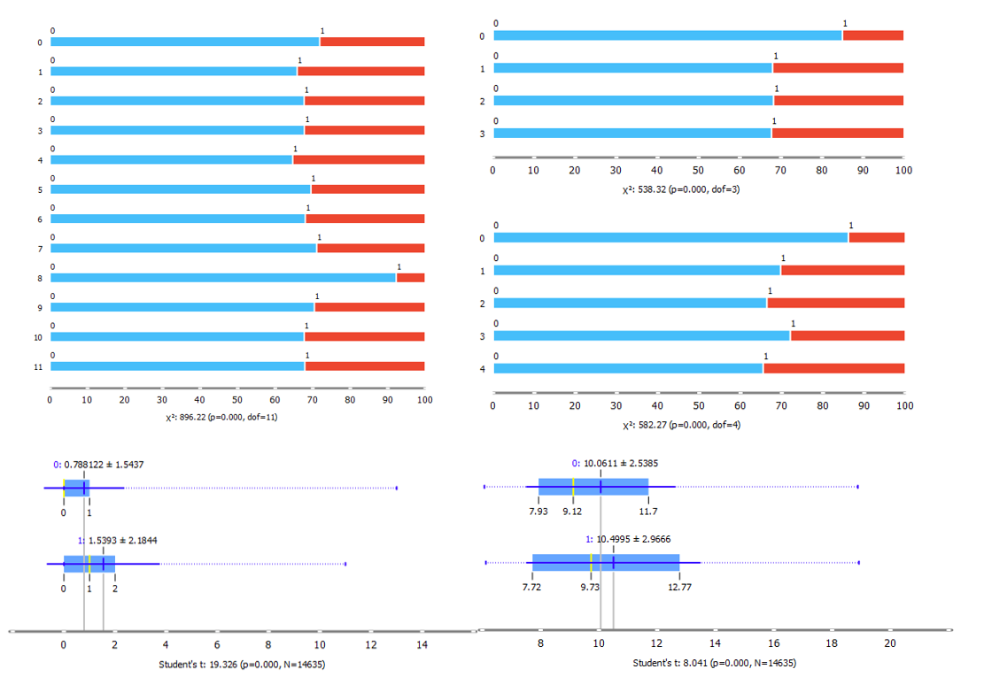
Feature Engineering
Figure 1: Box Plot Comparison of Complications and Other Features from Top-Down: Left - Month and Charlson Comorbidity Index, Right - Moon Phase, Day of Week, and Hour.

Slide 8
Profit & Cost Analysis
Measure | Meaning | Hospital Profit & Cost
True Positive | Postoperative complication is caught and treated | $13,000 [5]
True Negative | No postoperative complication | $19,000 [6]
False Positive | Patient unnecessarily treated for a complication | ($16,000) [5],[7]
False Negatives | Patient discharged with undiagnosed complication | ($92,000) [8]
Notes:
Identify our 1:6 threshold ratio.
Discuss effect of a disproportionate rate of false positives vs negatives. Better for the hospital to over predict complications, as the cost of care is much lower than the cost if they mistakenly release a patient who will have complications

Slide 9
Model Analysis
KNN
AUC: 83.9%
Specificity: 60%
Neural Network
AUC: 82.4%
Specificity: 62%
Logistic Regression
AUC: 82.0%
Specificity: 55%
Sensitivity: 90%
Sensitivity: 86%
Sensitivity: 90%
High sensitivity but low AUC and specificity
Low AUC
High sensitivity but low AUC and specificity

Slide 10
Model Analysis
Tree
AUC: 90.9%
Specificity: 74%
Random Forest
AUC: 92.3%
Specificity: 74%
Gradient Boost
AUC: 93.2%
Sensitivity: 85%
Sensitivity: 87%
Sensitivity: 90%
Specificity: 84%
High AUC
High AUC, high sensitivity
High sensitivity, highest AUC achieved

Slide 11
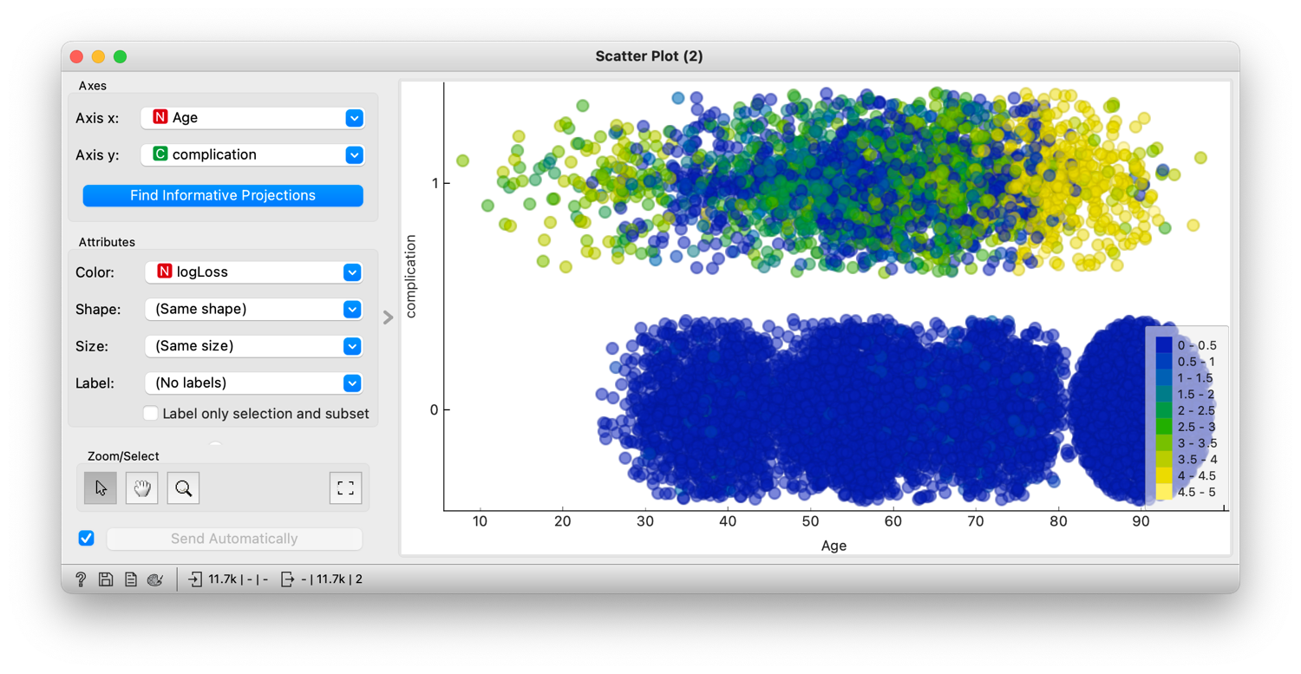
Investigating errors in prediction: Gradient Boosting
Figure 2: Age vs. Complication scatter plot of log loss values (error) of gradient boosted model.

Slide 12
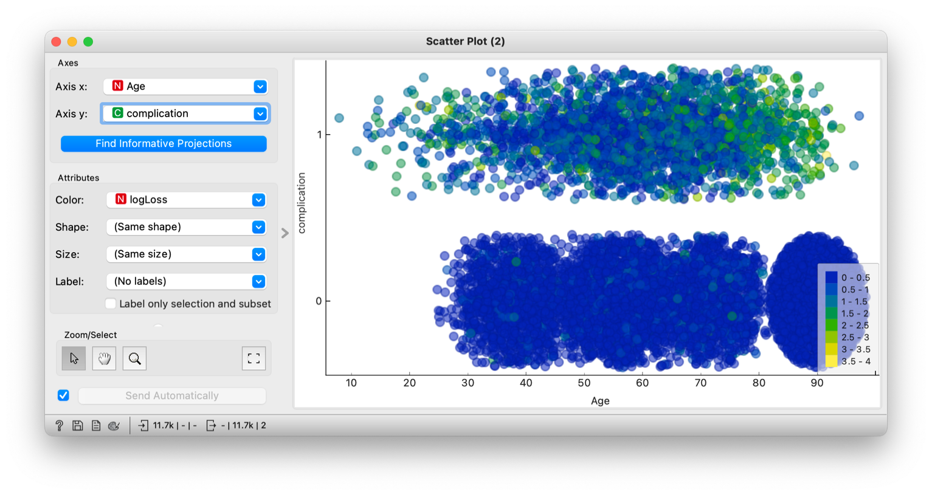
Investigating errors in prediction: Random Forest
Figure 3: Age vs. Complication scatter plot of log loss values (error) of Random Forest model.

Slide 13

Final model: Random Forest
Test AUC: 91.8%
Threshold: 22.2%
Sensitivity: 89%
Specificity: 78%
Notes:
Threshold of 18% provided recall of 92% (most important measure against false negatives) and precision of 70%. Testing set. AUC of 0.923.

Slide 14
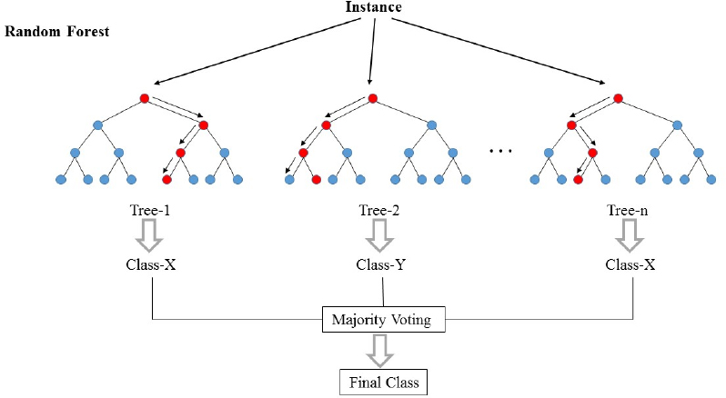
Final model: Random Forest

Slide 15
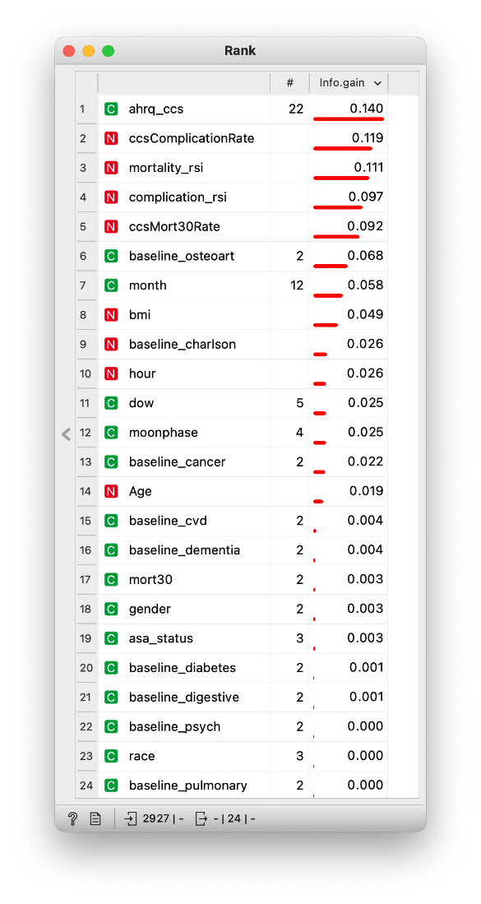
Insight
Complication largely dependent on type of surgery performed (inherent risks to different types)
Less healthy individual more prone to developing complications
Figure 4: Information Gain of Random Forest variables.
Notes:
The rank widget displays the information gain from each variable, which offers insight into the forest
Charlson comorbidity index
RSIs are risk stratfication indeces, and predict 30-day mortality and in-hospital complication using only administrative data.

Slide 16

Insight
Vulnerable patient population
Ensure safety and recovery, increased monitoring, follow-up appointments, and medication management
Proper education following surgery

Slide 17

Thank you!
Notes:
Overall, our model is successful in minimizing false negatives in sending a patient home who has an undiagnosed complication.
Although the model is predicting more false positives, that cost to a hospital is better than the alternative of the high cost of a false negative. Thank you.

Slide 18
References
[1] Tevis, S. E., & Kennedy, G. D. (2021). Risk prediction tools in surgery. Current Reviews in Clinical Anesthesia, 41(1), 51-58. https://doi.org/10.1007/s40290-021-00456-4
[2] Omnamahshivai. (2021). Surgical Dataset (Binary Classification). Kaggle. https://www.kaggle.com/datasets/omnamahshivai/surgical-dataset-binary-classification
[3] Agency for Healthcare Research and Quality. (2021). Clinical Classifications Software (CCS) for ICD-10- CM/PCS. https://hcup-us.ahrq.gov/toolssoftware/ccs/ccs.jsp#overview
[4] Faraoni, D., Eikermann, M., & Hajjar, L. A. (2011). What every anesthesiologist should know about risk stratification and prevention of postoperative nausea and vomiting: a systematic review of the evidence. Anesthesia and Analgesia, 112(4), 771-779. https://doi.org/10.1213/ANE.0b013e31820ad0b1
[5] Agency for Healthcare Research and Quality. (2017). Healthcare-Associated Infections in the United States, 2017. https://www.ahrq.gov/hai/pfp/haccost2017-results.html
[6] Bulger, E. M., Maier, R. V., Sperry, J., Joshi, M., Henry, S., & O'Keefe, G. (2011). An evidence-based prehospital guideline for external hemorrhage control: American College of Surgeons Committee on Trauma. Prehospital Emergency Care, 15(3), 309-317. https://doi.org/10.3109/10903127.2011.566261
[7] MyCreditSummit. (2021). Average Cost of a Hospital Stay. https://mycreditsummit.com/average- cost-of-a-hospital-stay/
[8] Kim, H. J., Park, S. H., & Park, H. K. (2011). Risk factors for postoperative nausea and vomiting after laparoscopic cholecystectomy. Journal of the Korean Surgical Society, 81(5), 307-313. https://doi.org/10.4174/jkss.2011.81.5.307
[9] Qualia Bio. (2021). Cost-to-Charge Ratios Trends Report. https://qualiabio.com/resources/inferences/cost-to-charge-ratios-trends-report

